Slide 1
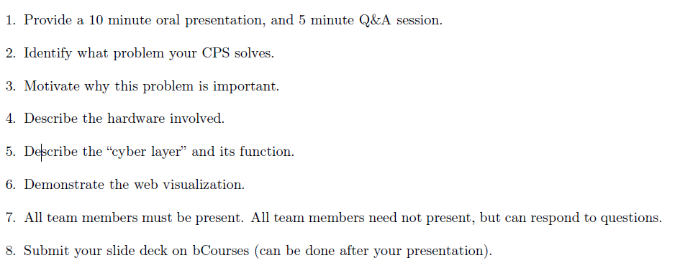
TEMP: presentation guidelines

Slide 2
TEMP: Problem
What are we trying to solve
Narrow down to specific aspects of problem
Quantify the issue; can cite experts
Find pain points
Make personal, but know audience
Why unique
Research competition and existing methods
What is unique about our team members?
Why does it matter
Quantify potential impact
Notes:
Vania

Slide 3
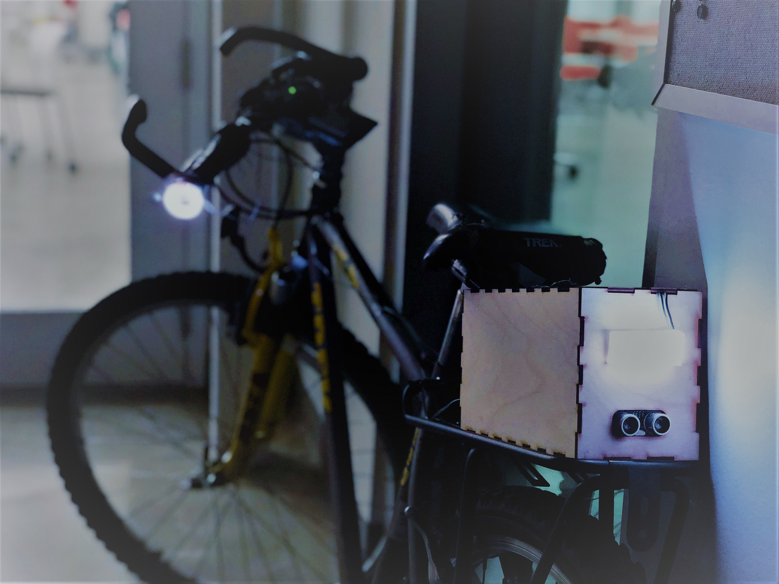
SMART SAFE BIKE
CE 186: Design of Cyber-Physical Systems
Vania Fong, Evey Huang, Justin Luke, Teng Zeng
Nov. 29, 2017
Notes:
Janton – Introduction: say hello and our team name
Everyone – say your name

Slide 4

The Big Picture
110,000 miles driven per capita
1.9 personal vehicles per household
1,083.5 Mton CO₂
+ pollutants SO₂, PM, NOx, CO
Our Destructive Driving Habits
☠ Linked to obesity and respiratory illnesses
35,092 Car Crash Fatalities (2015)
Source: DOT (2015)
Notes:
Janton – 11.29.2017
1.5 min

Slide 5
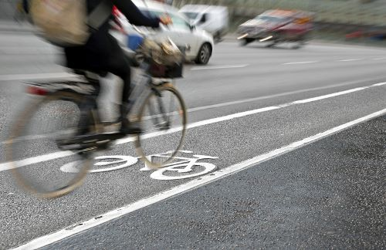
Solution – Biking?
45,000
Bike-riding injuries in the US (2015)
= 5 injuries per hour
Source: NHTSA (2015)
Notes:
Janton – 11.29.2017
- 8 sec
What is the safest route?
What route is best suited for me?
* elevation, time, difficulty, safety
Major Causes
Distracted Riding
Speeding
Proximity to Vehicles
Equivalent to 5 injuries per hour
Convenience
Bike friendliness

Slide 6

Have you ever..?
Considered using a bike for your commute?
Biked on unsafe roads?
Regret biking?
Notes:
Janton – 11.29.2017
1 min

Slide 7
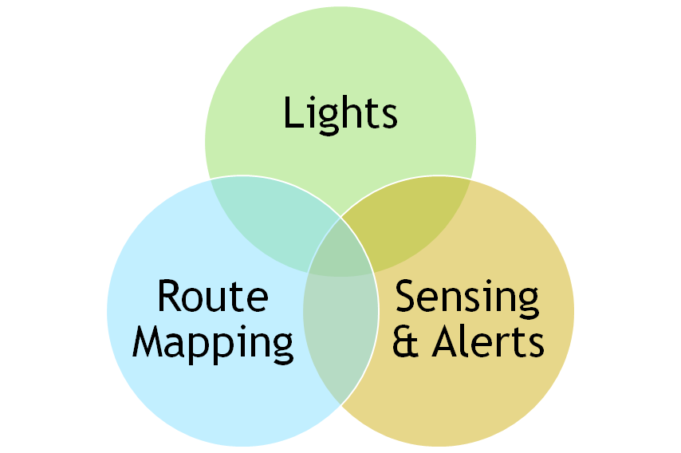
Solution Overview
Our Solution
A Smarter, Safer Biking Experience
Notes:
Vania (40 sec)
Our solution is to improve the biking experience
If you think about cars, all these features + becoming more advanced, especially the 'smart' cars
Auto emergency braking. ...
Lane detection
Blind-spot monitoring. ...
Backup camera.
However, to improve bike safety, most solutions for bikes only have one or two of these features, but we believe that all three are needed for an effective system

Slide 8
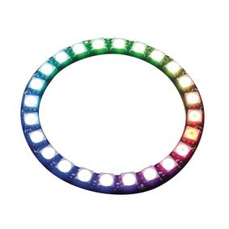
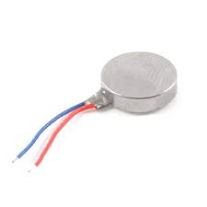
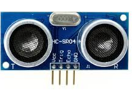
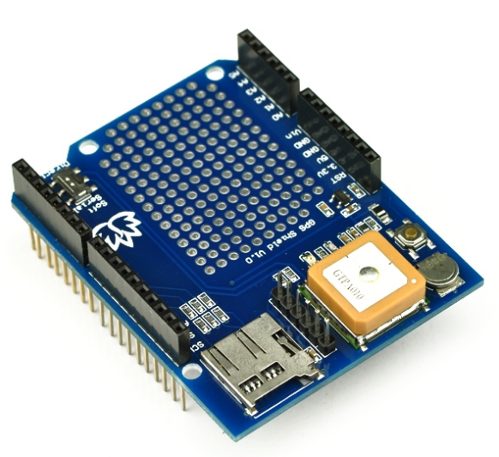
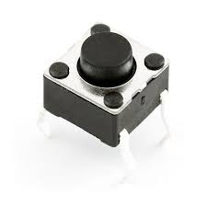
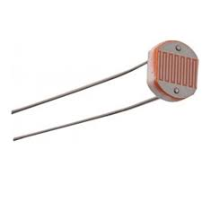
The Physical
NeoPixel Digital LED
Ultrasonic Sensor (HC-SR04)
Coin Vibration Motor
GPS Shield
Button
Photoresistor
Notes:
Vania
One of main goals is to make an integrated, on-bike safety system
Alerts both bikers and drivers
Inspired by features of car safety systems
GPS brains

Slide 9
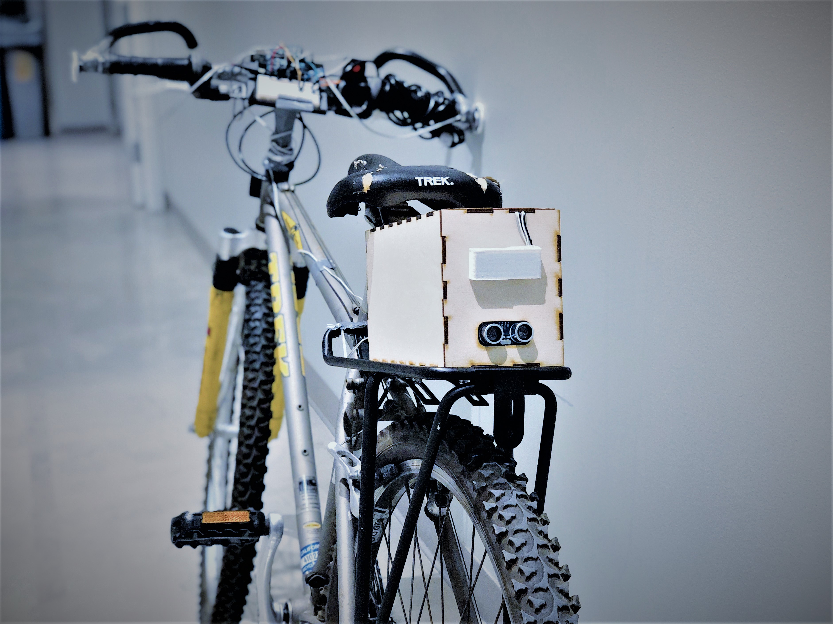
Live Demo
Notes:
Vania and Evey (Justin or Janton can lift bike for better visibility)
Turn lights
Vibration motor + Warning Light
Night light

Slide 10
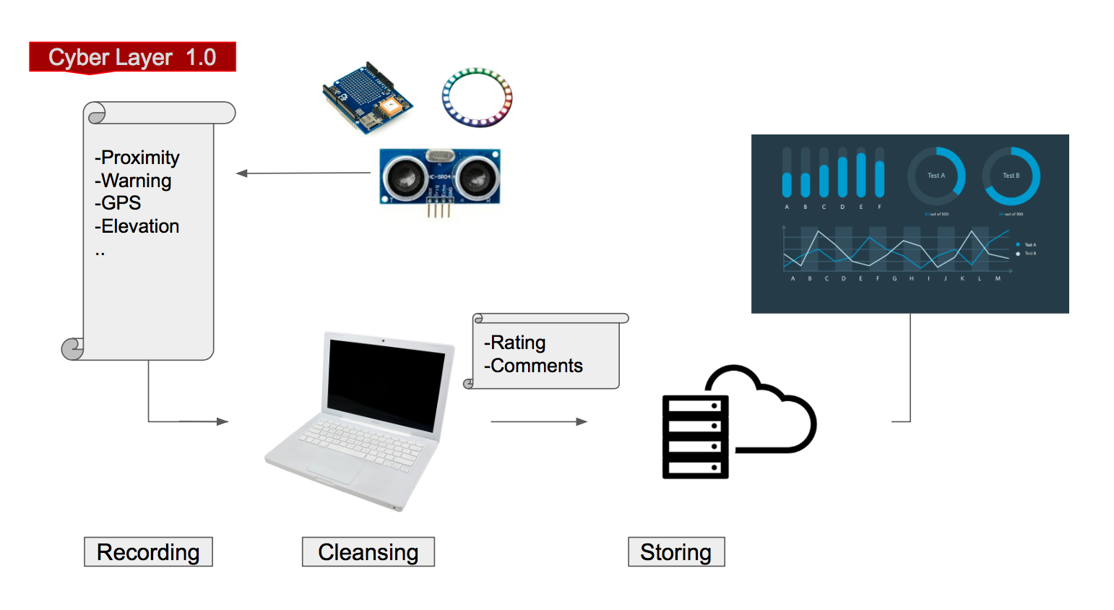
The Cyber
Notes:
Janton
(15 sec)

Slide 11
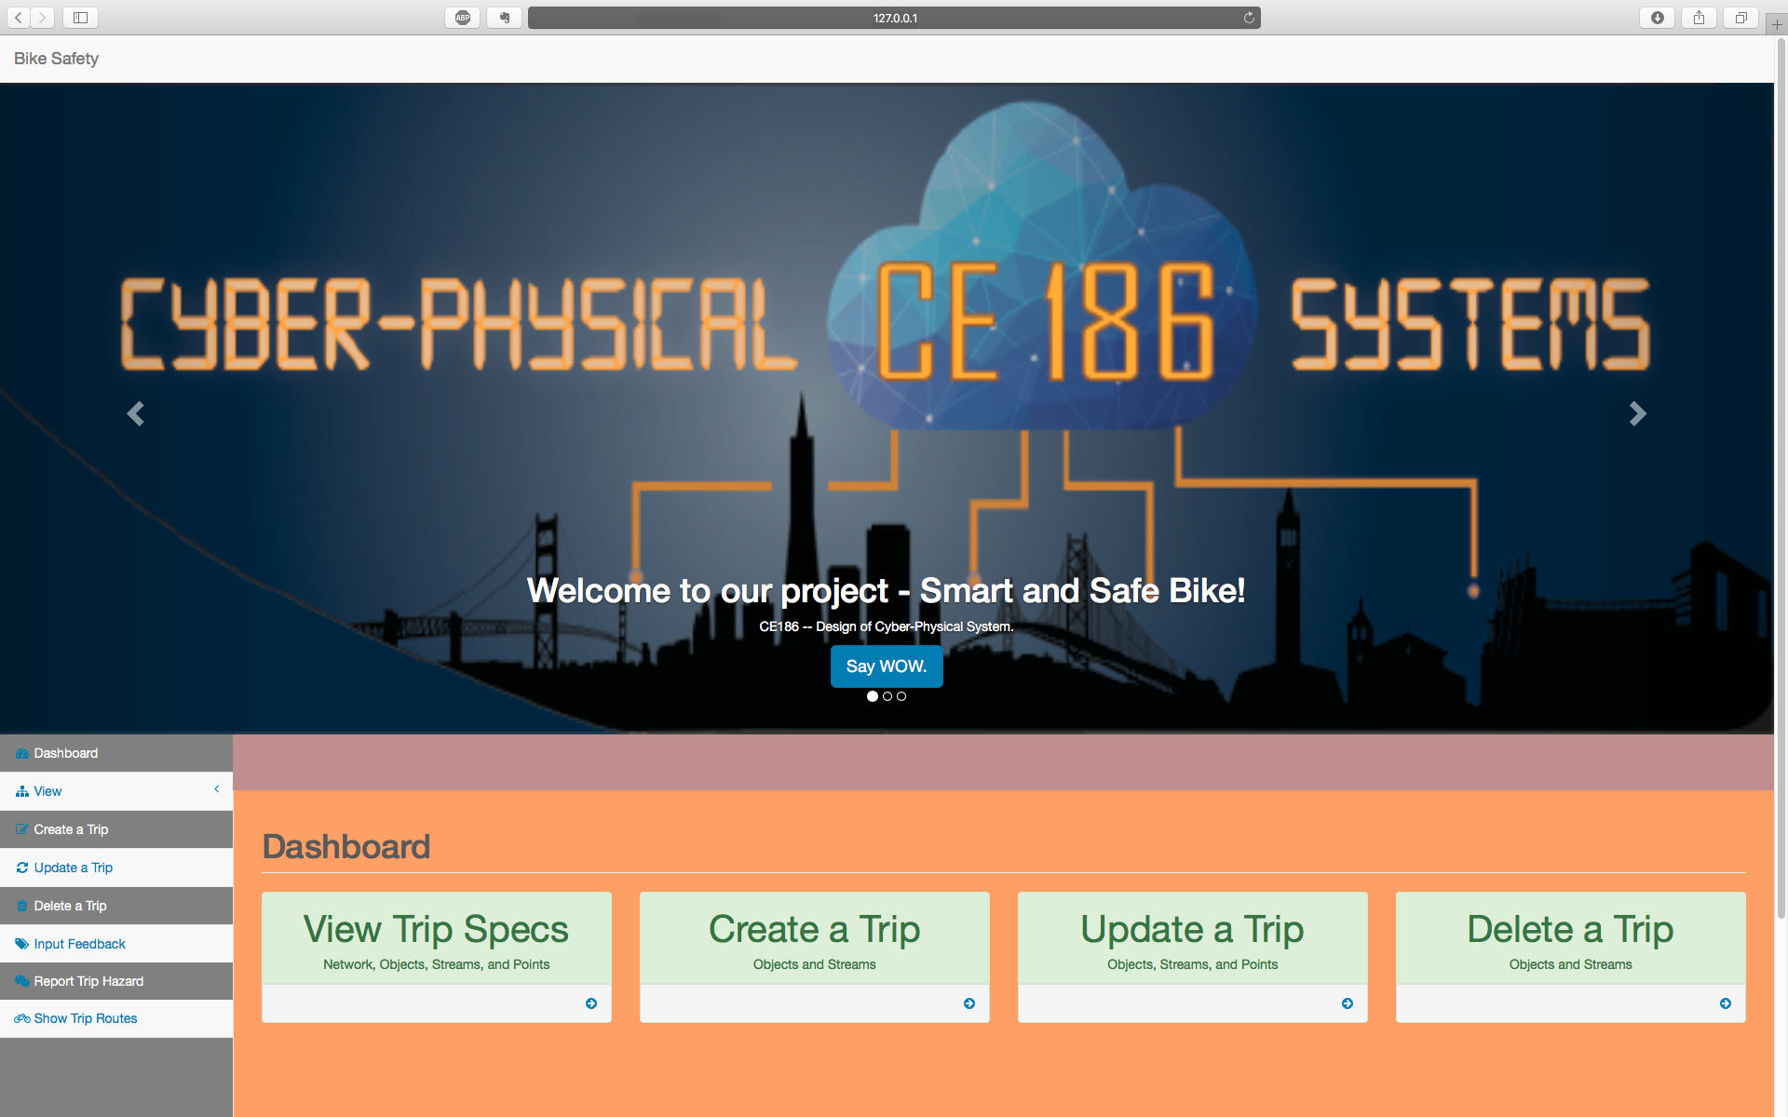
A CLOSER LOOK AT OUR SERVER…
Notes:
Janton
- 2min to describe all the features
-photo gallery
-details breakdown (examples, elevation)
-Route mapping (trip review – preview)
-User feedback --> transition to Justin

Slide 12
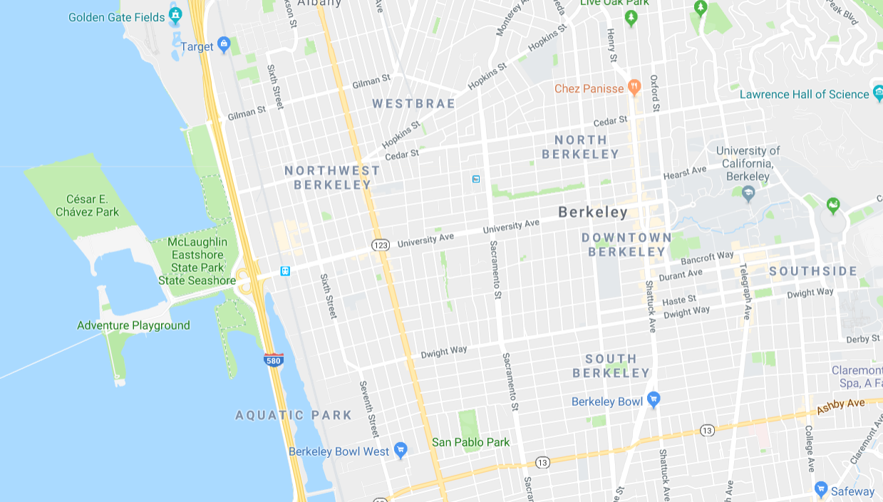




Notes:
Justin
(2 seconds; just “tapping” the left search tab to open it)

Slide 13


←
Find YOUR best route:
Berkeley Amtrak | ✖
Jacobs Hall | ✖
Notes:
Justin
(10 seconds)
Smart Safe Bike App is easy and intuitive. Let’s enter our starting point and desired destination.

Slide 14
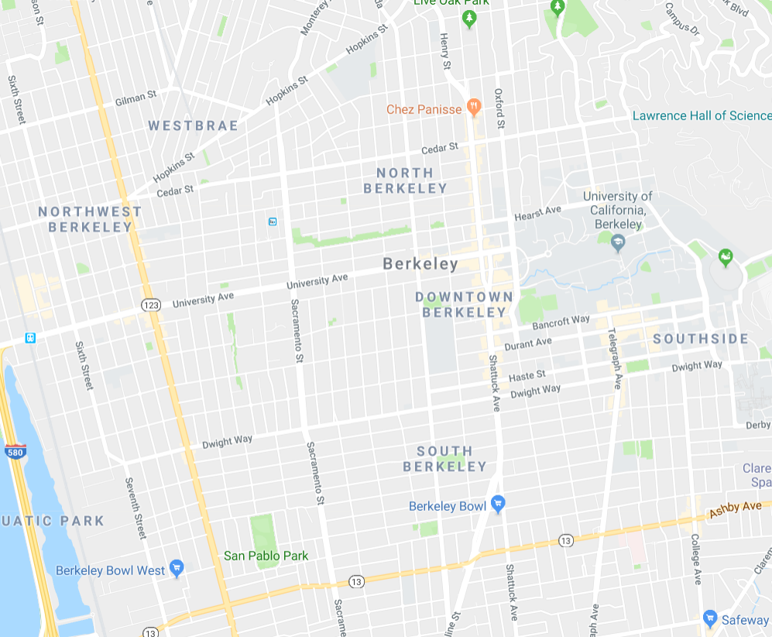

←
Find YOUR best route:
Berkeley Amtrak | ✖
Jacobs Hall | ✖
3
Recommended for you:
1
Least Hilly ★★★★★
4
2
1
1
2
☾ Safe at Night ★★★★☆
2
3
Scenic ★★★★☆
3
4
⌚ Fastest ★★★☆☆
Caution:
1
Close to vehicles
2
Reported bike thefts
3
Reported pot-holes
Notes:
Justin
(45 seconds)
1) Finds routes by other users with similar origin/destination
2) Recommends the top choices based on the user’s personalized preferences
3) Based on data collected by our sensors or by user feedback, we can warn users about dangers

Slide 15
←
Find YOUR best route:
Berkeley Amtrak | ✖
Reported by 15 users
Jacobs Hall | ✖
3
Recommended for you:
1
Least Hilly ★★★★★
4
2
1
1
2
☾ Safe at Night ★★★★☆
2
3
Scenic ★★★★☆
3
4
⌚ Fastest ★★★☆☆
Recommended by your friend, Jane Doe
Caution:
1
⚠ Close to vehicles
2
⚠ Reported bike thefts
3
⚠ Reported pot-holes
Notes:
Justin
(15 seconds)
“Tap” on the icons. Can see how this route/warning was generated.
Recommendations are weighted, based on similarity of other users and their ranking

Slide 16

←
→
Find YOUR best route:
John Wick
Level 10
3092 pts. | 299 ♥
41 Friends 👪
Berkeley Amtrak 🔍 | ✖
Jacobs Hall 🔍 | ✖
3
PREFERENCES
COMMUNITY
Recommended for you:
Based on your past ratings…
Flatter Terrain
|-------------------------------------|
Not important Important
Scenery
|-------------------------------------|
Not important Important
Speed
|-------------------------------------|
Slow Fast
1
⛰ Least Hilly. ★★★★★
4
2
1
1
2
☾ Safe at Night ★★★★☆
2
3
📷 Scenic ★★★★☆
3
4
⌚ Fastest ★★★☆☆
Caution:
1
⚠ Close to vehicles
2
⚠ Reported bike thefts
3
⚠ Reported pot-holes
Notes:
Justin
(30 seconds)
“Tap” on the user profile icon.
Levels, health points, friends. We know calories burned, since we track velocity and altitude.
Based on past trips John has made, we have learned his biking preferences. He can adjust them manually, too.
We note that the recommended routes shown previously match with John’s preferences

Slide 17

←
→
Find YOUR best route:
John Wick
Level 10
3092 pts. | 299 ♥
41 Friends 👪
Berkeley Amtrak 🔍 | ✖
Jacobs Hall 🔍 | ✖
3
PREFERENCES
COMMUNITY
Recommended for you:
Congratulations!
You earned this trophy for biking at least 3 times a week this past month:
+800 pts.
Calories Burned this week:
Team Miles this year:
1
⛰ Least Hilly. ★★★★★
4
2
1
1
2
☾ Safe at Night ★★★★☆
2
3
📷 Scenic ★★★★☆
3
4
⌚ Fastest ★★★☆☆
Caution:
1
⚠ Close to vehicles
2
⚠ Reported bike thefts
3
⚠ Reported pot-holes
Notes:
Justin
(30 seconds)
Besides making biking more safe with the hardware and safe route suggestions, the app also makes biking fun.
Connect with your friends and community. Compete with points or health score. Create Teams (schools, orgs, companies).

Slide 18
Future developments
Crowdsourced route reviews & recommendations
Provide personalized safety tips based on riding habits
Social Incentives & Gamification
Wireless data transmission capability
Multidirectional hazard sensing
Optimal button placement
Notes:
Vania: Hardware side (30 sec)
Justin: Software side (10 seconds) (mostly already discussed earlier, so I’ll just say “the app visualization shown previously is our next step of Smart Safe Bike App once we scale the product to many users”)

Slide 19

Vision
IMPROVING SAFETY
Integrated Alert System
Crowdsourced Intelligence
Promote Safe Habits
ENCOURAGE BIKING by
3.8 Gigatons of Carbon
Healthy Lifestyles
Transportation Costs
Notes:
Vania or Janton?
GHG Reduction if /3 americans biked to work 30 days in a year

Slide 20
Summary / Q&A
Increase adoption of biking as a transportation mode by:
Improving rider safety
Providing a valuable biking resource: personalized route optimization
Creating a platform for an inclusive biking community
Result:
Fewer road injuries and deaths
Reduced greenhouse gas and air pollutant emissions
Healthier community
Better city planning
Thank you! Questions?
Notes:
Justin (15 seconds) Not going to say much because this is already presented. Just going to leave this slide up so it’s useful for the judges/audience when asking questions (i.e. jogs their memory)

